Slide 1
EL 2
Waqar Yar

Slide 2
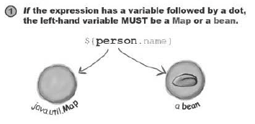
EL Variable
The first variable is either an implicit object or an attribute.
The value to the right of the “.” is a map key or bean property

Slide 3
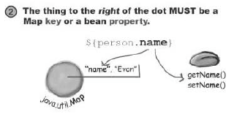
EL Examples

Slide 4
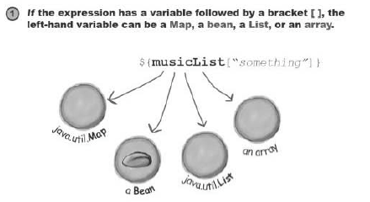
The [] operator
The “.” Operator works only for Map or Bean.
The [] Operator can work for an array or list as well.

Slide 5
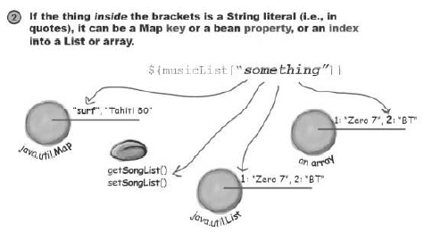
The [] operator

Slide 6

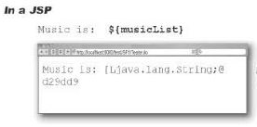
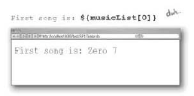
[] Operator Example

Slide 7
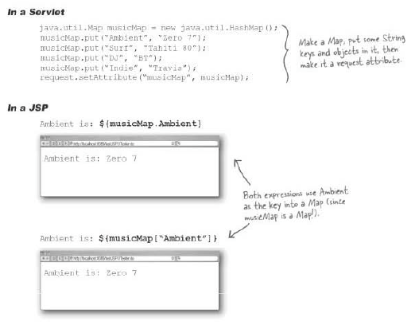
[] Operator Example

Slide 8

Search for an attribute

Slide 9
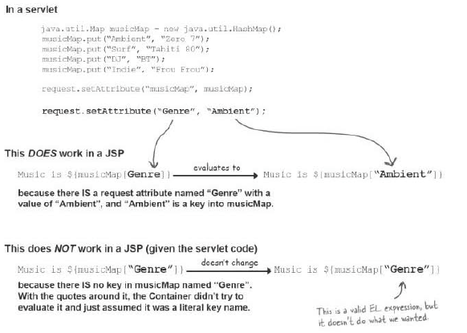
[] Operator Example

Slide 10
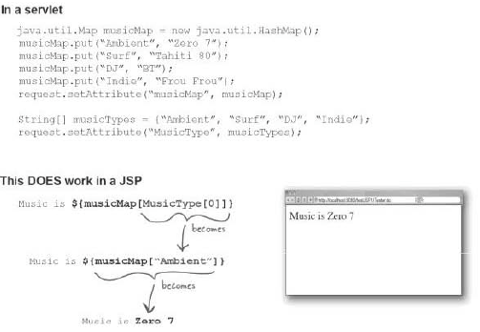
Nested Expression in [] Operator

Slide 11
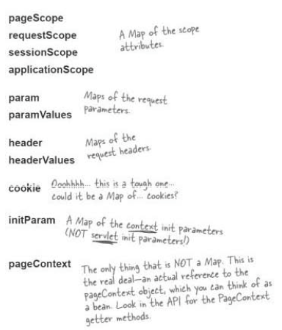
Implicit EL objects

Slide 12
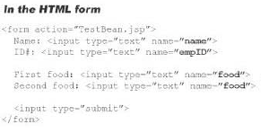
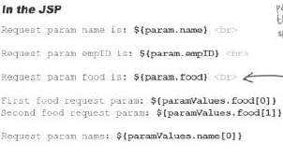
Example of Implicit EL Objects.

Slide 13
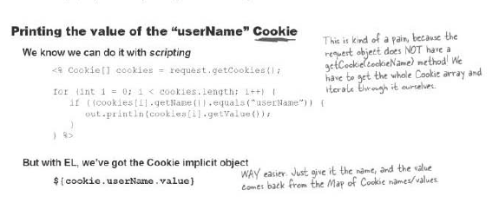
Getting Cookie from EL

Slide 14



Getting the Context init Parameter

Slide 15
What is XML?
XML stands for EXtensible Markup Language
XML is a markup language much like HTML
XML was designed to store and transport data
XML was designed to be self-descriptive
XML is a W3C Recommendation

Slide 16
Difference between XML and HTML
XML and HTML were designed with different goals:
XML was designed to carry data - with focus on what data is
HTML was designed to display data - with focus on how data looks
XML tags are not predefined like HTML tags are

Slide 17
XML Example
<product>
<name>ProductOne</name>
<description>Product One is an exciting new widget that will simplify your life.
</description>
<cost>$19.95</cost>
</product>

Slide 18
XML is Extensible
<product>
<name>ProductOne</name>
<description>Product One is an exciting new widget that will simplify your life.
</description>
<cost>$19.95</cost>
<shipping>$2.95</shipping>
</product>

Slide 19
How can XML be Used
XML Separates Data from Presentation
XML is Often a Complement to HTML
Transaction Data
Stocks and Shares
Financial transactions
Medical data
Mathematical data
Scientific measurements
News information
Weather services

Slide 20
XML News Example
<?xml version="1.0" encoding="UTF-8"?> <nitf> <head> <title>Colombia Earthquake</title> </head> <body> <headline> <hl1>143 Dead in Colombia Earthquake</hl1> </headline> <byline> <bytag>By Jared Kotler, Associated Press Writer</bytag> </byline> <dateline> <location>Bogota, Colombia</location> <date>Monday January 25 1999 7:28 ET</date> </dateline> </body> </nitf>

Slide 21
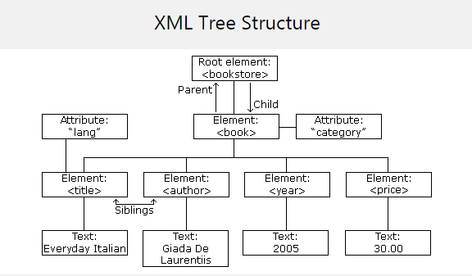
XML Structure

Slide 22
XML Attribute Example
<?xml version="1.0" encoding="UTF-8"?> <bookstore> <book category="cooking"> <title lang="en">Everyday Italian</title> <author>Giada De Laurentiis</author> <year>2005</year> <price>30.00</price> </book> <book category="children"> <title lang="en">Harry Potter</title> <author>J K. Rowling</author> <year>2005</year> <price>29.99</price> </book> <book category="web"> <title lang="en">Learning XML</title> <author>Erik T. Ray</author> <year>2003</year> <price>39.95</price> </book> </bookstore>

Slide 23
XML Syntax Rules
XML Documents Must Have a Root Element
The XML Prolog
All XML Elements Must Have a Closing Tag
XML Tags are Case Sensitive
XML Elements Must be Properly Nested
XML Attribute Values Must be Quoted
White-space is Preserved in XML

